Slide 1
FGCT5002: The Conscious Practitioner 25/26 Fandom and Fan Cultures
Dr Digdem Sezen

Slide 2
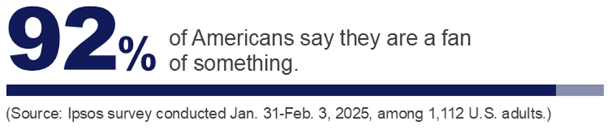
If almost everyone is a fan, what does being a fan actually mean?

Slide 3

Fandom and Cult
Fan: A person who have a strong interest in or admiration for a particular person or thing.
Fandom: The state or condition of being a fan of someone or something.
Cult:
A relatively small group of people having beliefs or practices, especially relating to religion, that are regarded by others as strange or sinister or as imposing excessive control over members.
A person or thing that is popular or fashionable among a particular group or section of society.

Slide 4
Individually, please answer these questions in 3-4 minutes, you may take notes:
What are you a fan of? (Game, franchise, genre, creator, studio, streamer…)
How do you show or express that fandom? (Playing, creating art, following updates, buying merch, modding, streaming, etc.)
What’s one reason that fandom matters to you? (Community? Inspiration? Escapism? Creative drive?)

Slide 5
In pairs or trios, briefly discuss:
What fandoms do you share?
What’s different about how you engage with the objects of your fandom?
Are you fans in similar or different ways (passive/active, casual/intense)?
Have your fandoms influenced your creativity or interest in games?

Slide 6
What kind of fans are you?
What are your key observations?
Who..
…has cosplayed a game character?
…moderates a Discord server?
…owns fan merch?
…has met online friends through a fandom?
…has made fan art or mods?

Slide 7

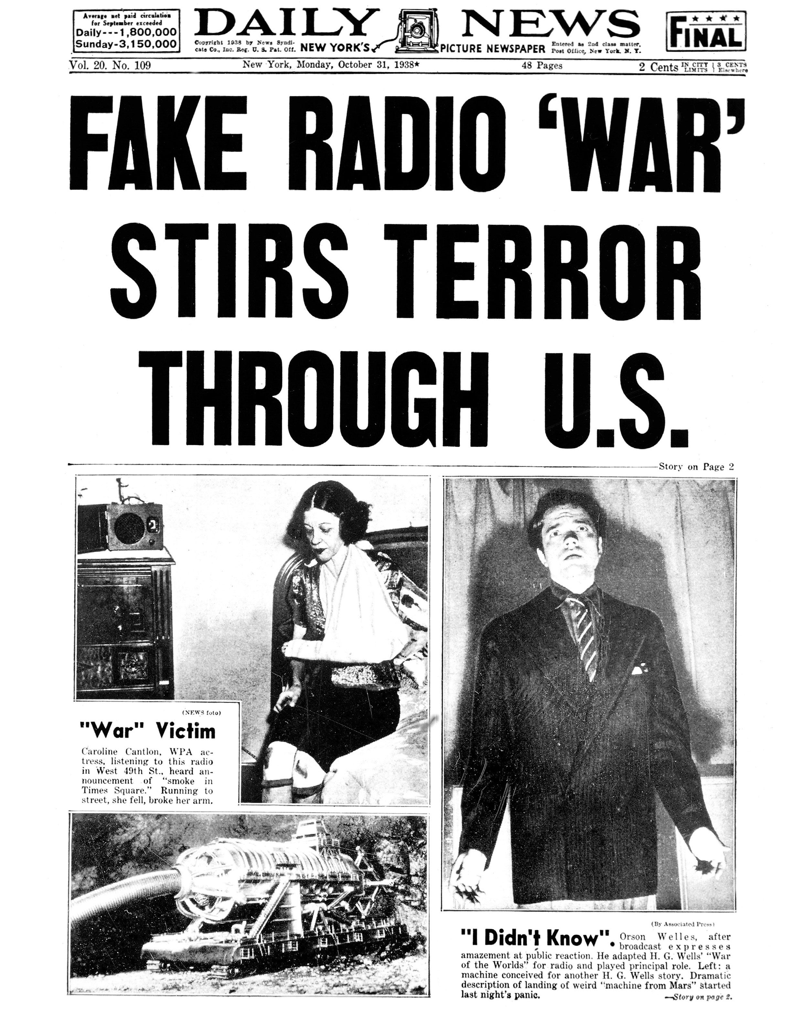
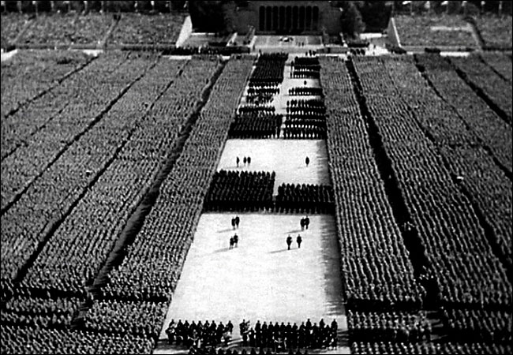
The Frankfurt School
Culture is produced by a capitalist system to reflect capitalist values, the system is controlled by the bourgeoisie, the ruling class: Mass culture reinforces the dominant ideology!
The people, the proletariat, do not make their own culture, they absorb bourgeoisie values through consuming capitalist culture and identify those values as their own. By so the ruling class imprint their ideology on the border population: Mass culture distracts the workers from their oppression!
This status quo of rich people producing and controlling culture to be consumed by the poor is maintained without a revolution: Consumers of mass culture are ‘cultural dupes!
Mass culture has no ‘cultural’ value!
Max Horkheimer (1985-1973) & Theodor W. Adorno (1903-1969)

Slide 8
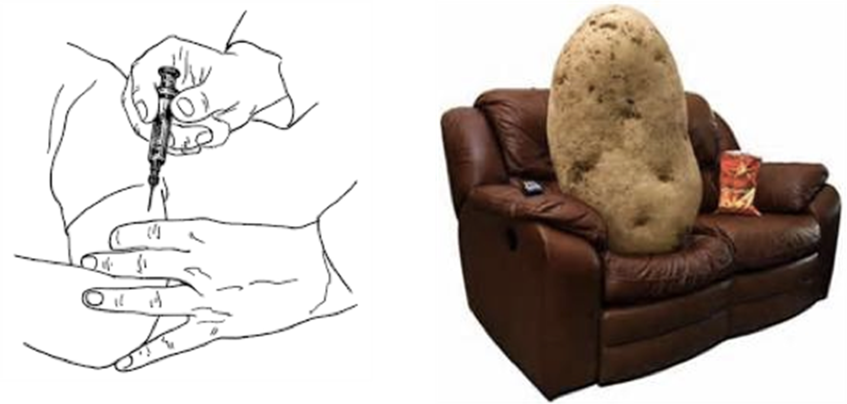
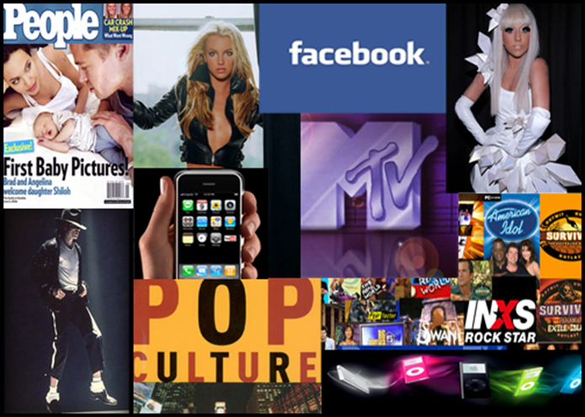
The Hypodermic Needle
The hypodermic needle model is a model of communication suggesting that an intended message is directly received and wholly accepted by the receiver.
"Hypodermic Needle Theory" was based on early observations of the effect of mass media, as used by Nazi propaganda and the effects of Hollywood in the 1930s and 1940s.
It suggests that the media injects its messages straight into the passive audience.
This passive audience is immediately affected by these messages. The public essentially cannot escape from the media's influence, and is therefore considered a "sitting duck". Or a couch potato.

Slide 9
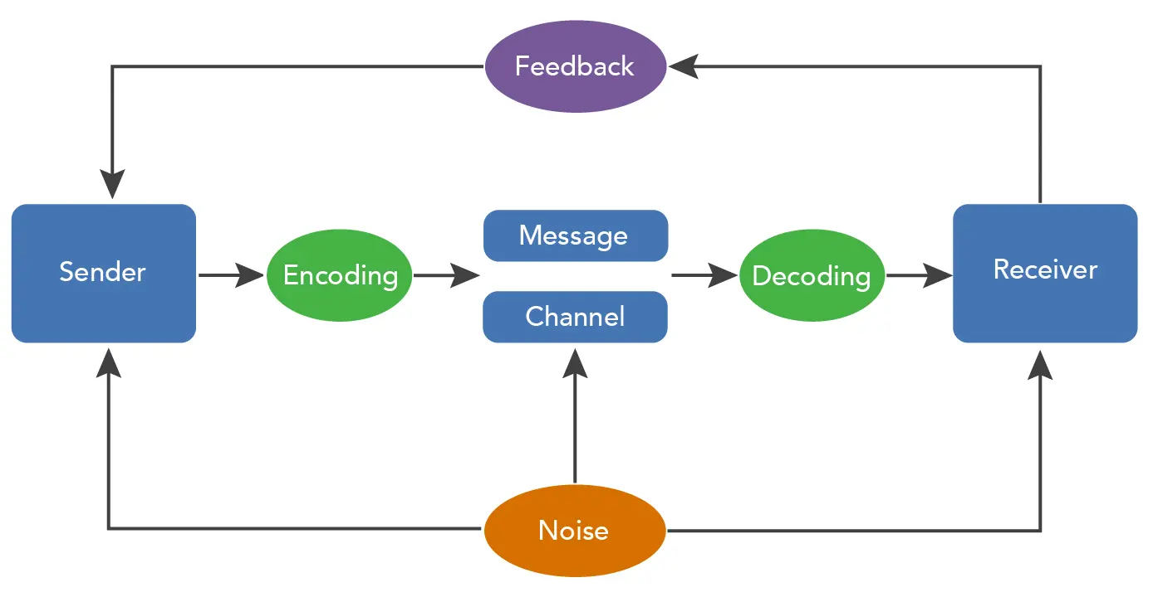
Encoding and decoding
Meaning is not simply fixed or determined by the sender.
The message is never transparent.
The audience is not a passive recipient of meaning.
Even meaning originates in text, viewers/readers are permitted some freedom within its structure.
There is an interaction between the producer, the programme, and the viewer.
Stuart Hall, 1973

Slide 10
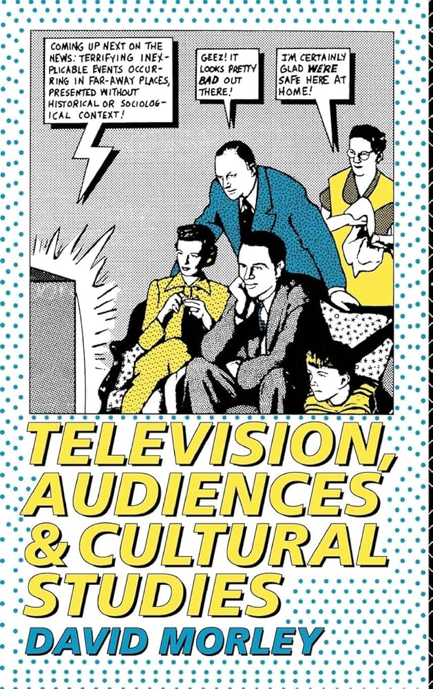
Active audience
Active audience theory argues that media audiences do not just receive information passively but are actively involved, often unconsciously, in making sense of the message within their personal and social contexts.
Decoding of a media message may therefore be influenced by such things as family background, beliefs, values, culture, interests, education and experiences.
David Morley, 1993

Slide 11

Reading as poaching
Reading is a foundational mode of modern consumption, and therefore, of everyday life.
Consumption is not a passive act determined by systems of production.
Everyday life works as a process of poaching on the territory of others, using the rules and products that already exist in culture in a way that is influenced, but never wholly determined, by those rules and products.
Reading as an everyday practice also becomes a field for poaching.
In this context the reader is perceived as an active and creative participant of the reading process.
Those who create some meaning can never be aware that it would be decoded in one possible way.
Michel de Certeau, 1984

Slide 12
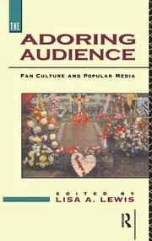
Fandom & Shadow cultural economy
Fandom is a common feature of popular culture in industrial societies.
It selects from the repertoire of mass-produced and mass-distributed entertainment certain performers, narratives or genres and takes them into the culture of a self-selected fraction of the people.
They are then reworked into an intensely pleasurable, intensely signifying popular culture that is both similar to, yet significantly different from, the culture of more ‘normal’ popular audiences.
All popular audiences engage in varying degrees of semiotic productivity, producing meanings and pleasures that pertain to their social situation out of the products of the culture industries.
But fans often turn this semiotic productivity into some form of textual production that can circulate among – and thus help to define – the fan community.
Fans create a fan culture with its own systems of production and distribution, a ‘shadow cultural economy’ that lies outside that of the cultural industries, yet shares features with them which more normal popular culture lacks.
John Fiske, 1992

Slide 13
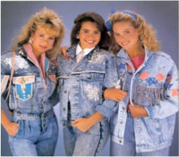

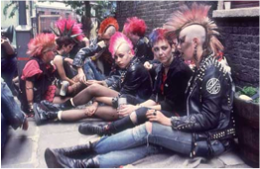
Circulation between regular and shadow economies

Slide 14
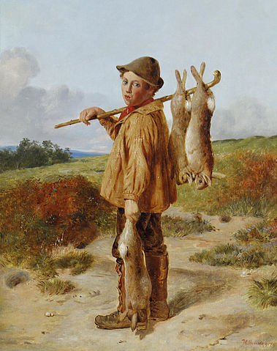
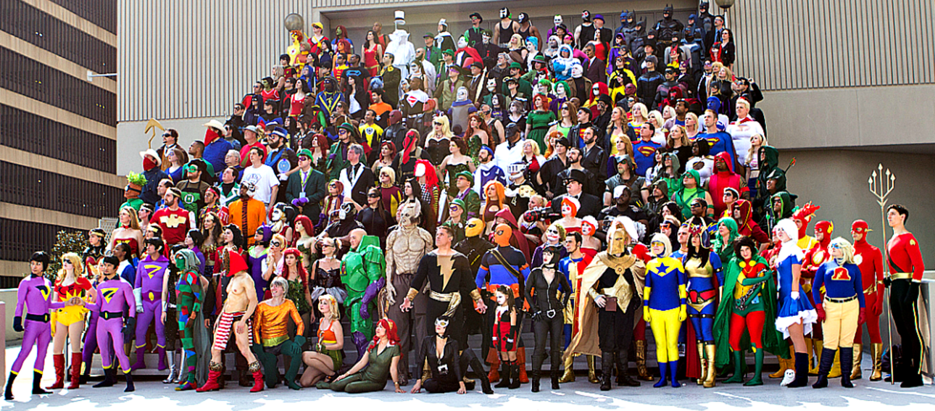
Textual Poachers
Fans in position of cultural marginality and social weakness.
Culture industry strong and powerful.
Fans appropriation mass-produced texts for own ends, cultural production, social interaction.
Fans are poachers who get to keep what they take and use their plundered goods as the foundation for the construction of alternative cultural community.
Henry Jenkins, 1992

Slide 15
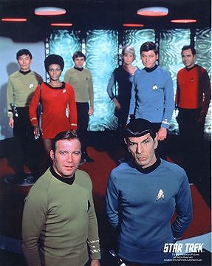
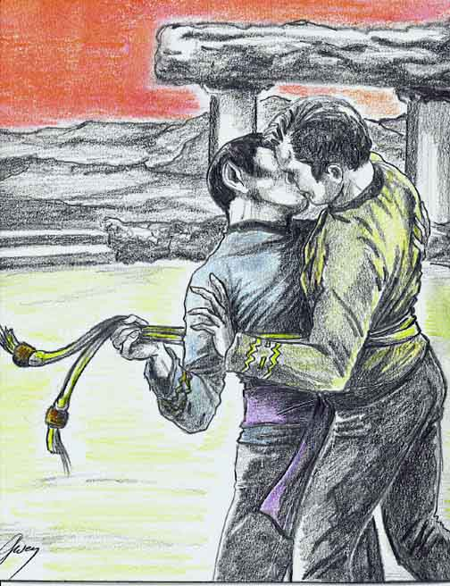
Fan fiction as textual poaching
Ordinary fans writing stories about favourite TV show characters.
These are distributed through post, fanzines, internet websites.
They detail backstories, expand characters, and develop sexuality.
Fan fiction subverts/develops original texts

Slide 16
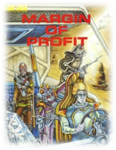

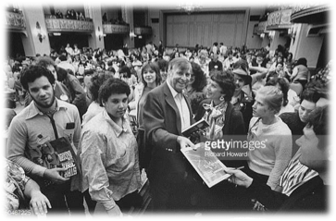
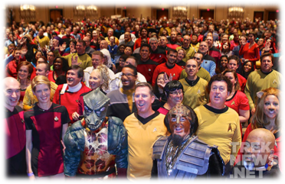

Star Trek as a Case Study:
Fan production keeping interest alive after commercial circulation ended
Making hardcore fans happy
Maintaining a relationship with an organised fan base

Slide 17

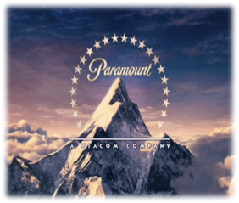

Commercial and legal limitations of fan production
To share (or not to share) creative control with fans?

Slide 18
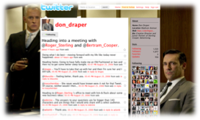
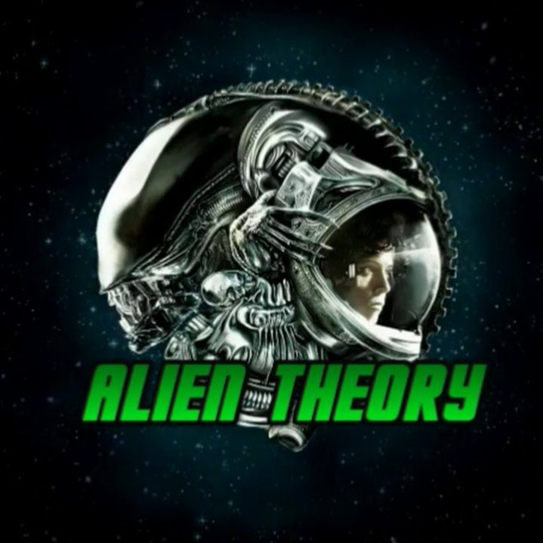

Social media, wikis and fan production
Visibility & Engagement Creative Input Popular Opinions and Gatekeeping

Slide 19
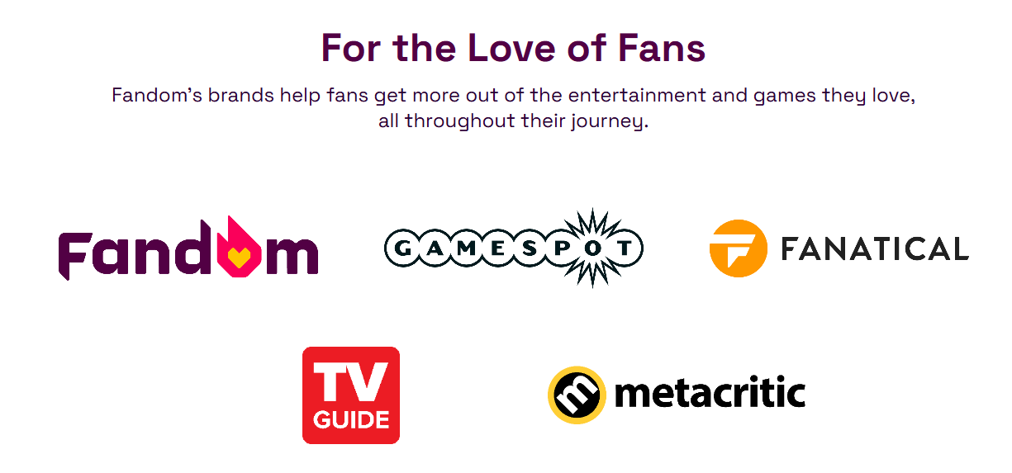
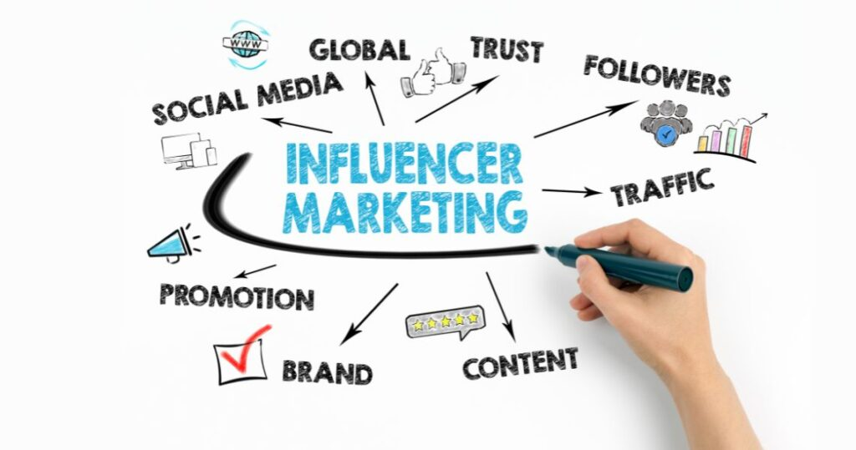
Brand authenticity & Fandom
Brand authenticity is no longer solely constructed by corporations but co-produced through fan engagement.
Brand rejuvenation strategies increasingly rely on “algorithmic authenticity,” where platforms authenticate brands through user-generated metrics like shares and hashtag trends.
For brands, this shift necessitates redefining authenticity as a negotiated outcome between institutional narratives and fan interpretations.
Beverland, 2005; Iglesias et al., 2020
“Fandom Inc explores how fan identities, behaviours, expectations are evolving, and how companies can engage accordingly.” (Fandom 2022)

Slide 20
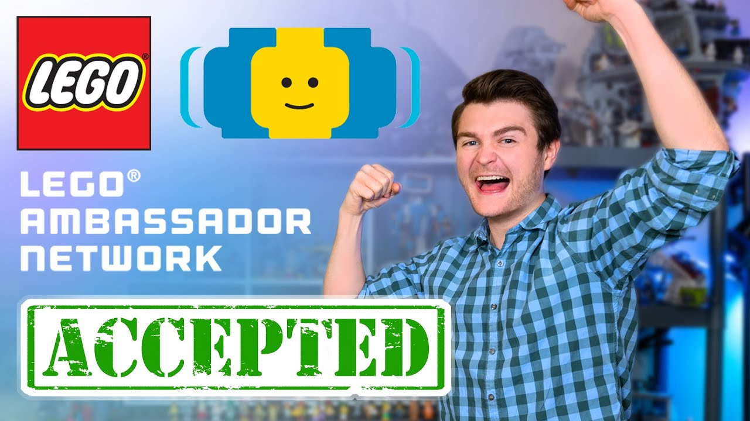
Emotional investments and labour
Leveraging digital platforms, fans engage in strategic emotional investments and labour—manifesting in content creation, cultural interpretation, and community governance—to collectively reshape brand heritage and authenticity.
Platform architectures mediate emotional labour processes, enabling brands to transition from passive heritage guardians to active cultural innovators.
Legacy brands co-manage fan communities, collaborate with super-fans, and utilize algorithmic environments to sustain both cultural relevance and commercial viability.
Chen Qiu, 2025

Slide 21
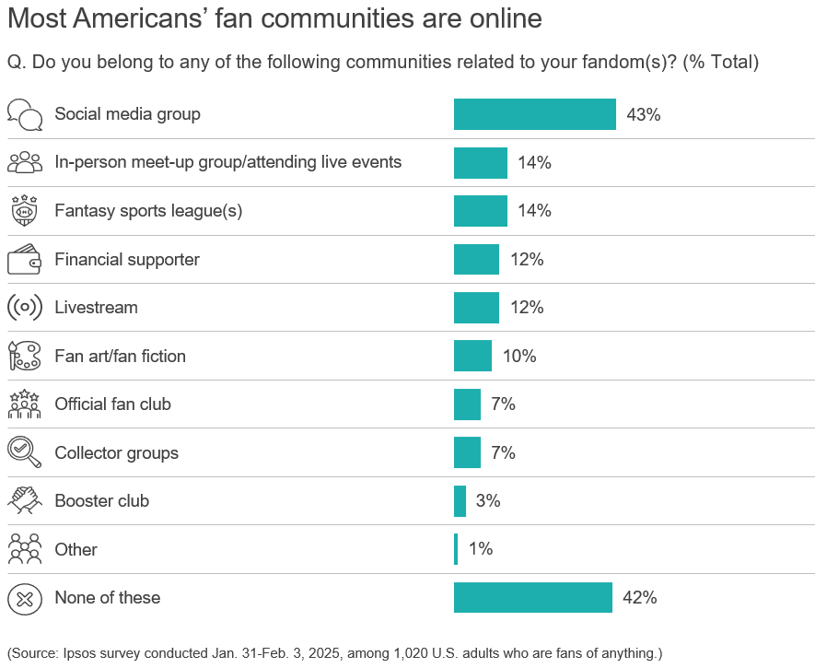
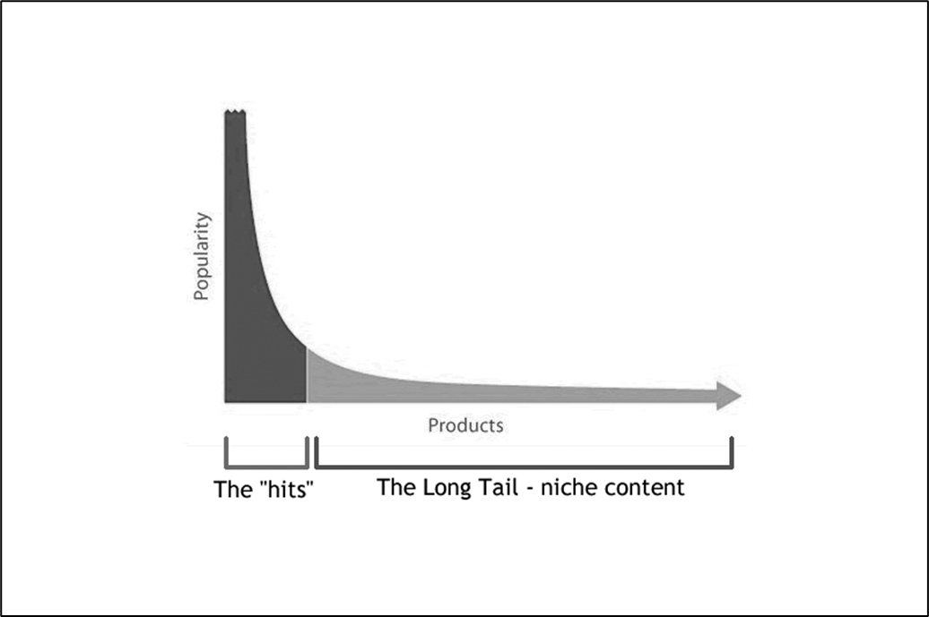
Fandom is mainstream, but…

Slide 22
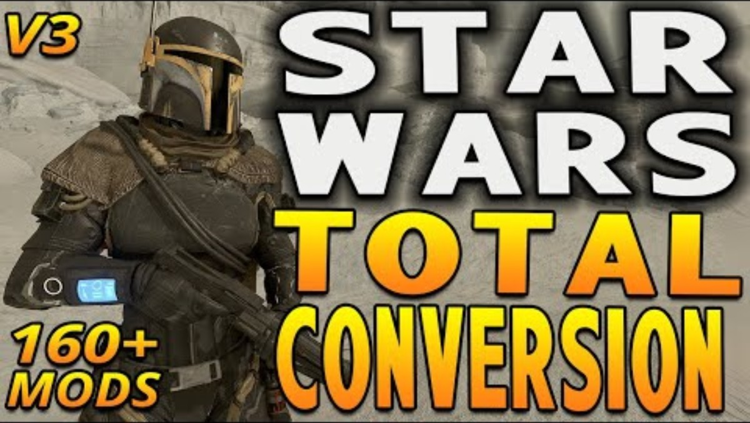
Fandom and gaming
Fan art…
Mods…
Streaming…
Community building…
Esports…

Slide 23
Game Fandom Ecosystem Mapping Exercise
As a group, create a fandom map showing how fans, the industry, and games interact:
Core object of fandom: the game/studio/IP. etc.
Fan activities: modding, streaming, tournaments, cosplay, art, memes, fanfic, community organising etc.
Industry engagement: marketing, updates, events, collaborations, official fandom programs, etc.
Platforms/spaces: Twitch, Reddit, Discord, TikTok, conventions, etc.
Tensions: monetisation, fan backlash, representation, community toxicity, corporate control, etc.
And other…
The map should show relationships and provide examples when possible.
Be ready to discuss the following using your map:
How do fans contribute creatively or economically to this game’s success?
How does the industry respond to or manage this fandom?
What tensions or ethical issues arise between fans and companies?
How do you as artists/designers imagine working with or designing for a fandom?

